Slide 1
ERASMUS+
Javier Fombona fombona@uniovi.es;
https://www.unioviedo.es/aei/

Slide 2
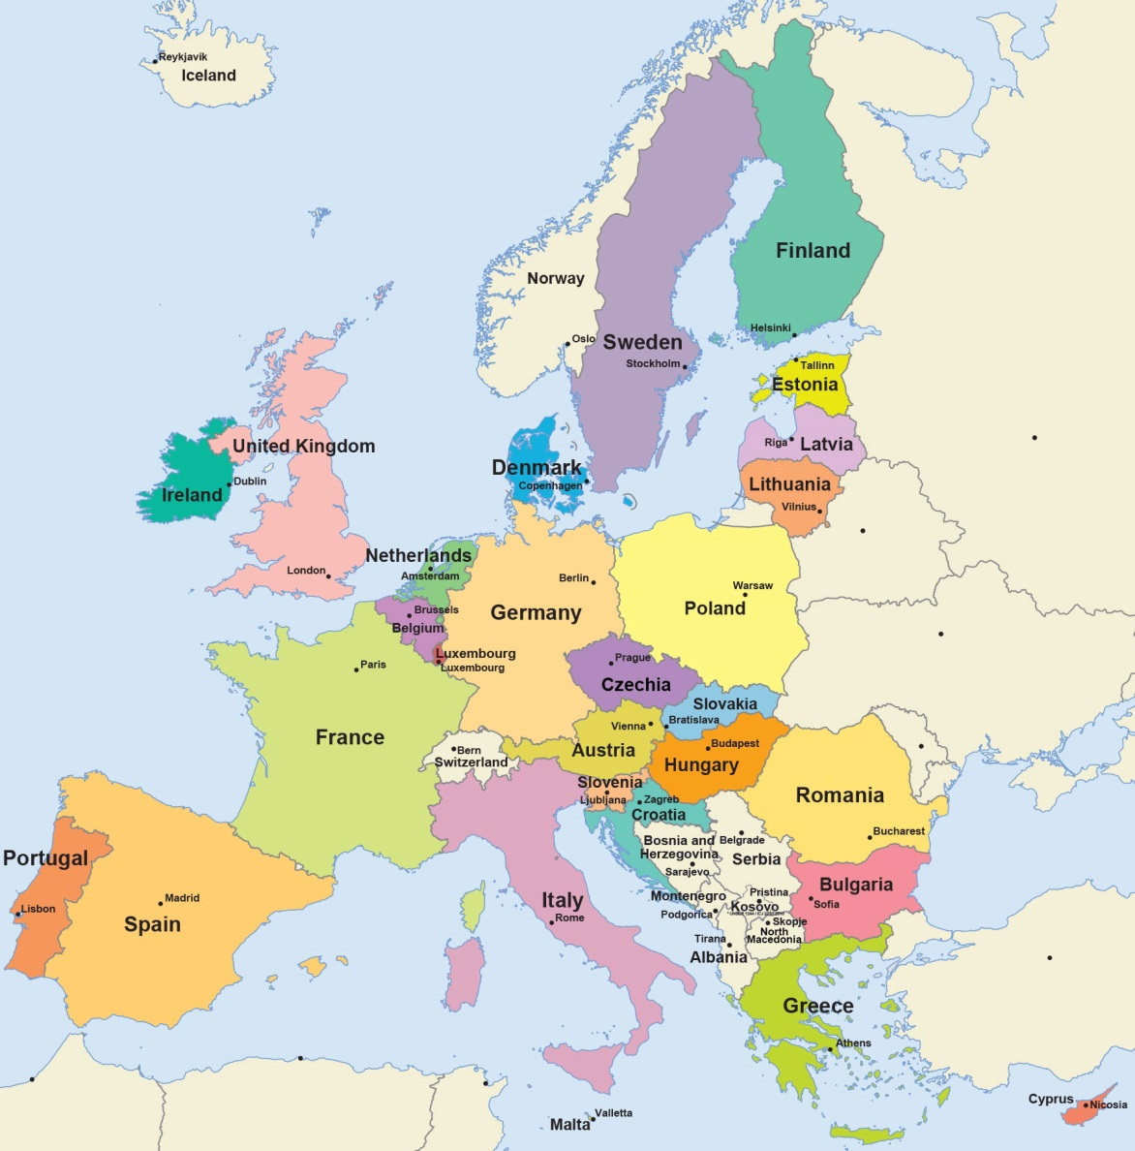
Principal objetivo
Main goal Erasmus
Construir la Unión europea con acciones formativas
To build the European Union through educational actions

Slide 3
KA1 Movilidades estudiantes Students mobility
KA101 niveles inferiores al universitario. Levels lower than university.
KA102 Formación Profesional. Vocational Training.
KA103 Educación Superior. Higher Education.
KA104 Educación de Adultos. Adult Education.
KA107 países fuera de la UE. To countries outside the EU.
KA116 Formación Profesional. Vocational Training.
KA2 Movilidad para la cooperación académica / Academic cooperation - Associations
KA201 Educación Escolar básica y media. Basic and Middle School.
KA202 Formación Profesional. Vocational Training.
KA203 Enseñanza Superior. Higher Education.
KA204 Educación de Adultos. Adult Education.
KA219 entre centros escolares. Among schools.
KA3 Reformas Políticas. Political Reforms
Erasmus subprograms

Slide 4
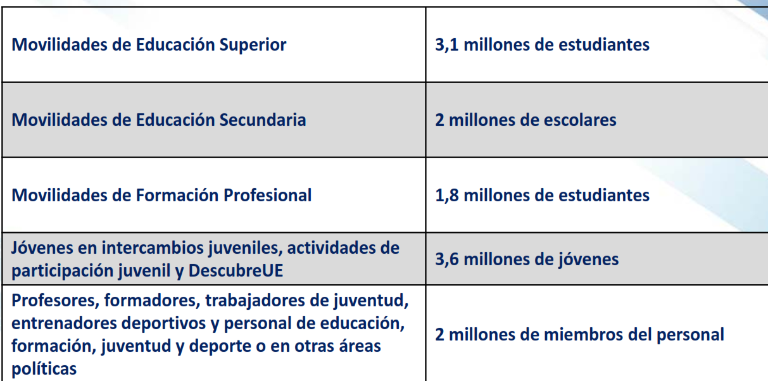
Relevance of the Erasmus program
KA103 Higher Education: more than 3 million students
KA101 Secondary School: more than 2 million students
KA102 Vocational Training: more than 1,8 million students
Other subprograms: more than 3,6 million youth people
Teachers and educational staff: more than 2 million people

Slide 5
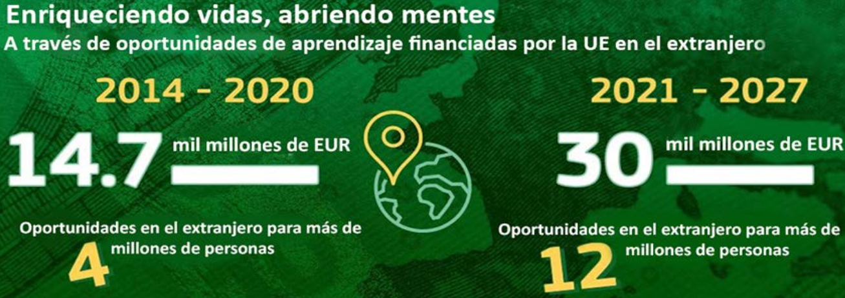
Two thousand fourteen to two thousand Twenty
Four million people
Fourteen million euros
Two thousand twenty one to two thousand twenty seven
Twelve million people
Thirty million euros

Slide 6
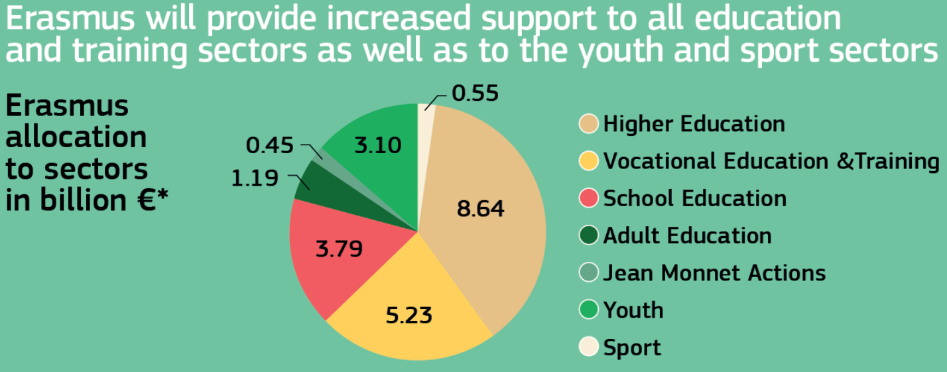
an emerging sector

Slide 7
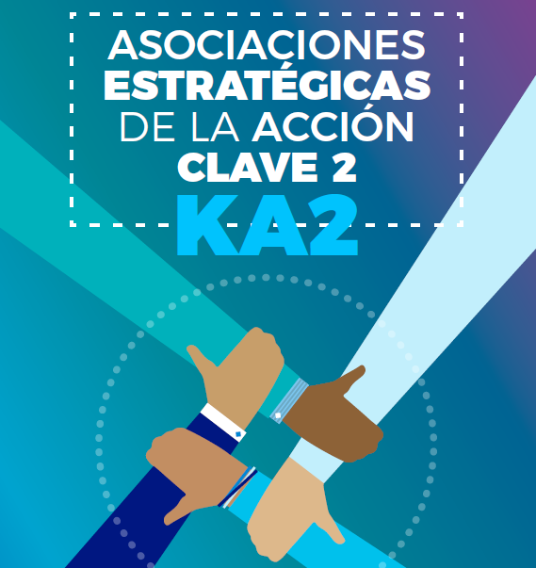

Slide 8
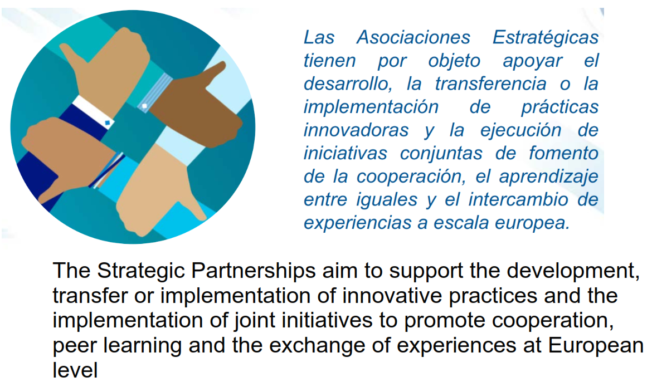
Nuestros objetivos
Docentes conozcan e implementen buenas experiencias
Our goals
Teachers knowing and implementing good experiences

Slide 9
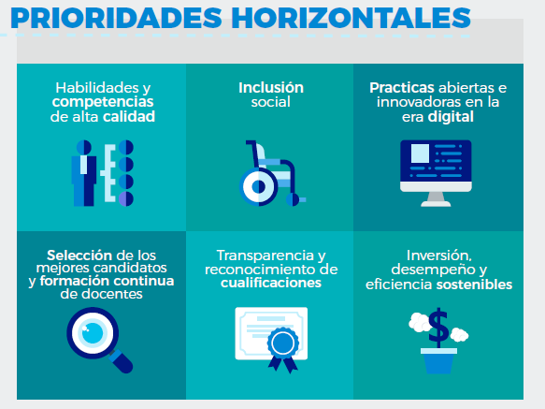
The EU sets specific priorities for all Erasmus programs (social inclusion, skills development, ICT….), which we have included in this project…

Slide 10
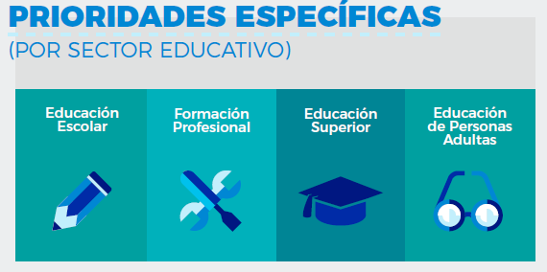
The EU sets specific priorities for the ADULT EDUCATION program (improve adult teachers skills, improve the participation….), which we have included in this project…

Slide 11
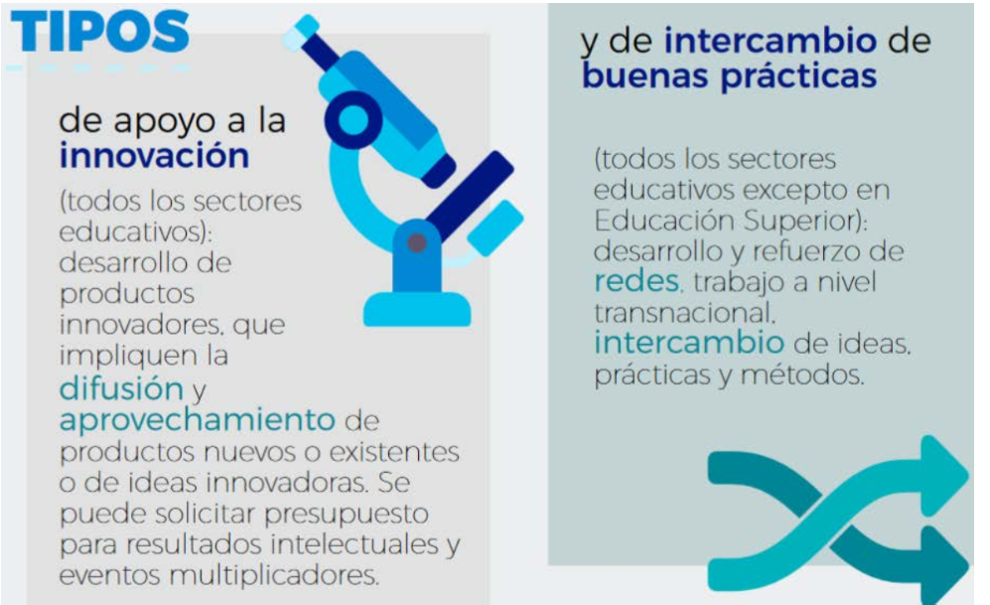
There are 2 types of projects:
- To Innovate
- To exchange good practices.
Our project is TO INNOVATE, based on the exchange and implementation of good practices.

Slide 12
Specific activities:
development of innovative practices,
cooperation with regional authorities,
transfer to citizenship,
teacher training ...

Slide 13
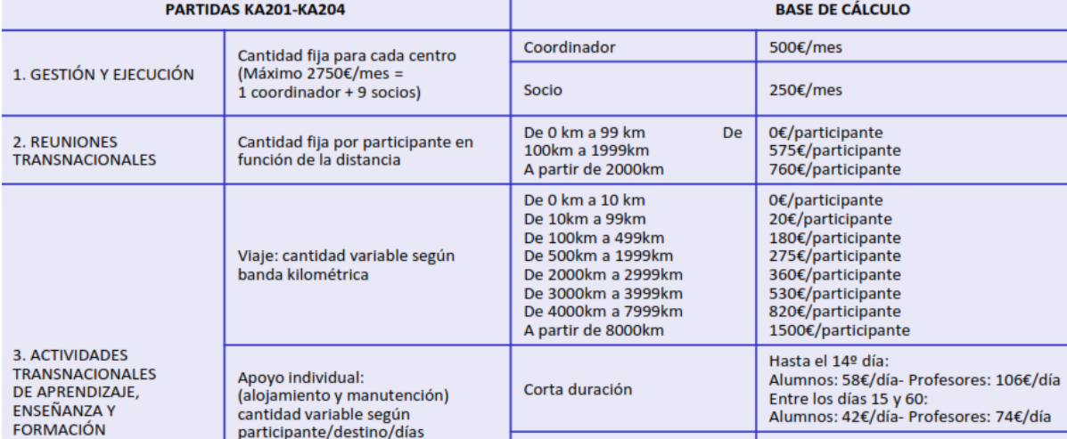
Erasmus determines financial support per person & distance.

Slide 14
ERASMUS is an experience to enjoy building Europe
Javier Fombona fombona@uniovi.es;

